Slide 1
Teaching Computation in Physics Using SageMathCloud
CoCalc
Todd Zimmerman
University of Wisconsin – Stout
Menomonie, Wisconsin
Inspiring Innovation. Learn more at www.uwstout.edu

Slide 2
Collaborative Calculations
Open source software
Runs “virtual” Linux machines
SageMath
Jupyter Notebooks
Python 2
Python 3
Octave (Matlab clone)
R
Scala, Julia, etc
Notes:
Actually containers run in Docker, not full virtual machines
Can do other things like Latex, Markdown, and anything you can do in Linux that doesn’t require x-window (x11)
Also have a separate Vpython kernel

Slide 3
What is SageMath?
Open-source alternative to Maple, Mathematica, Matlab, and Magma
Built on Python
Notebook format similar to Jupyter

Slide 4
How to use CoCalc
Run image of CoCalc in Docker
All free and open source
Use servers at CoCalc.com
Free and paid accounts
Projects
Single “virtual” Linux machine
Unlimited projects

Slide 5
Course Management
Assignments
Can be collected and graded
Handouts
Ungraded documents
Notes:
Copy and paste email address list into box to add students. They will be sent an email to join the course

Slide 6
Assignments
Notes:
Assign – push documents to the student account (you can see what they are doing in their account
Collect – a copy of each students’ assignment is made to your account to look at and make comments – doesn’t affect student copy
Grade – Enter a grade along with comments
Return to student – push copy of file with your comments back to student – separate from their original work

Slide 7
Assignments
Notes:
Assign – push documents to the student account (you can see what they are doing in their account
Collect – a copy of each students’ assignment is made to your account to look at and make comments – doesn’t affect student copy
Grade – Enter a grade along with comments
Return to student – push copy of file with your comments back to student – separate from their original work

Slide 8
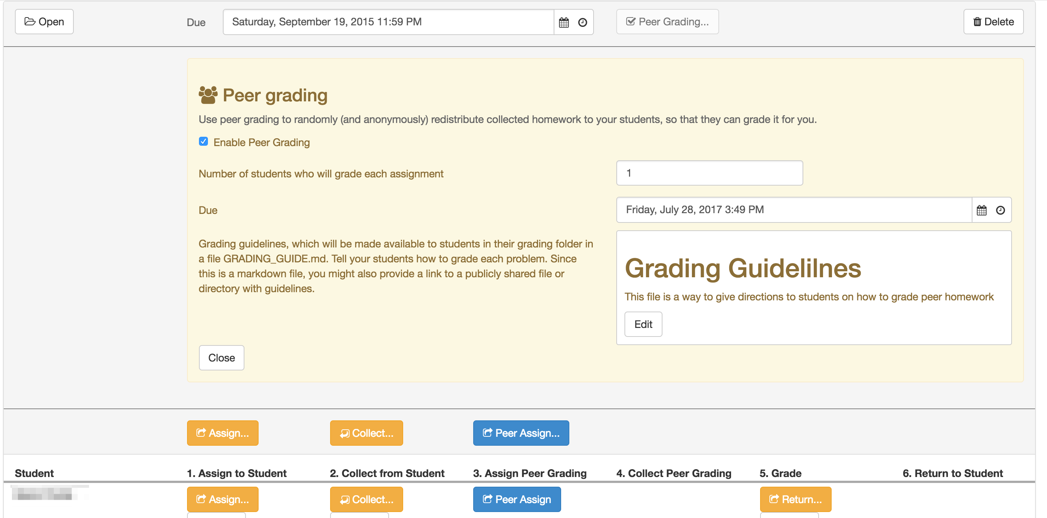
Peer Grading
Notes:
You must still manually grade assignment.

Slide 9
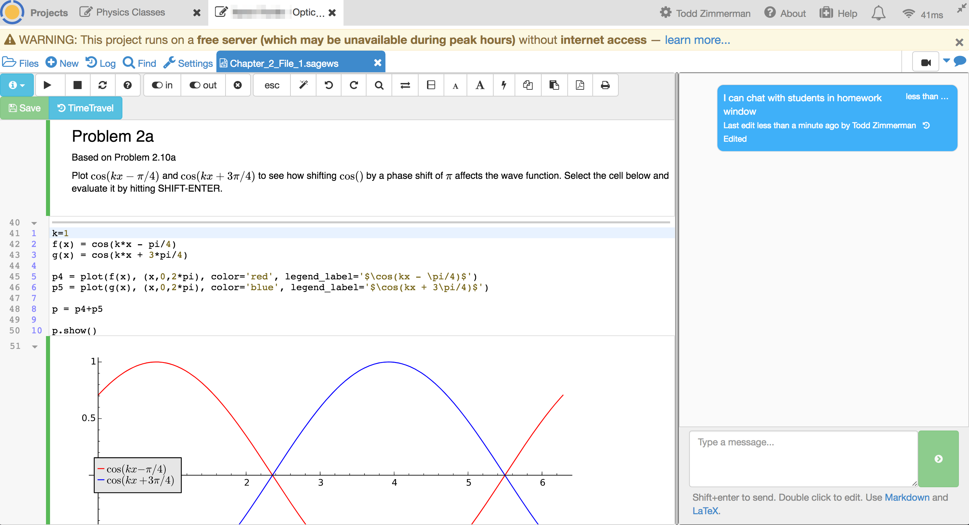
Chat Feature
Notes:
All SageMath and Jupyter notebooks have a chat feature between you and the student

Slide 10
How I use it
Introductory Physics
VPython modeling in Jupyter
Statics
Solving systems of equations in SageMath
Peer grading
Physics Modeling for Game Designers
Learning how to program Python in Jupyter
Optics and Quantum Mechanics
Solving homework problems in SageMath
Writing up homework in LaTeX
Peer grading

Slide 11
Benefits
No need for students to install any software
Time Travel
Easy collaboration
Fast customer support
LMS for computation
Notes:
Consistent computational environment – no worries about each student having a slightly different version of some package
Time travel saves all edits so you can go back to a previous version – helpful if student accidentally erases their solutions
Excellent customer support

Slide 12
Limitations
Free accounts at CoCalc.com can be sloooooow

Slide 13
Alternatives
Github Classroom
repl.it
Trinket
Notes:
Your current LMS and Github Classroom require downloading code. Things like repl.it and Trinket don’t have same functionality and flexibility of CoCalc.

Slide 14
Thank You
Thanks to the UW-Stout Office of Research and Sponsored Programs for financial support
SageMath Worksheets at:
https://github.com/zimmermant/physics_with_smc

